Slide 1
Ethical Issues of Computer Science
Last Name/First Name
Institutional Affiliation

Slide 2

Introduction
Computer science has continued to create endless opportunities and choices that have been very instrumental in the interpretation of ethics in recent years.
As such, based on the importance that they possess to society, safeguarding them from manipulation and destruction is significant.
However, the lack of effective policies and mechanisms to guide individuals while using the computer has led to the emergence of unique ethical problems such as hacking and cyber terrorism that have caused security scare in society.
Notes:
Computers and internet have been adopted in all areas of the society; use of computers to store and process vital information and the use of the internet to access information has rapidly become part of our everyday life (Margolis & Ryoo, 2012).
As such, people have been urged to always consider computer ethics in a way that is more meticulous as far as stopping crime and greening the earth through sustainability is concerned.

Slide 3
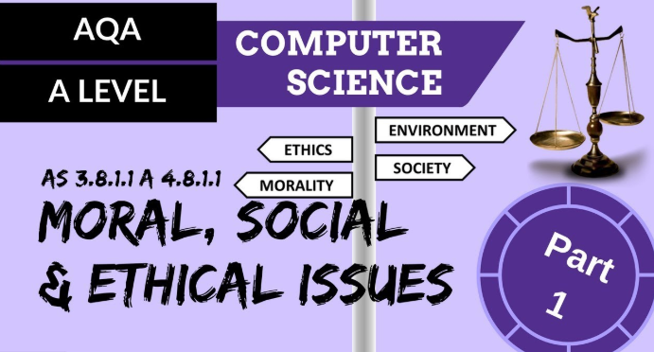
Ethical issues of computer science
Privacy, accuracy, property and accessibility (PAPA) have always been listed as the four ethical issues relating to computer science.
The continued advancement in information technology has given rise to the infringement of people’s privacy (Kuzu, 2019).
The advancement has brought about increased valuing of information, thereby attracting illegal acquisition of information.
The computers have made gathering of large amount of information easy, and as such, this has put people’s personal information in a vulnerable position.

Slide 4
Ethical issues of computer science Cont’
There is the mismanagement and mishandling of information that is delivered through ICTs thereby tampering with accuracy.
Information might fall on wrong hands, and this might lead to the mismanagement of people’s lives, especially when this individual has more power and authority.
The question of intellectual property rights has been the most confronted and complicated ethical issue.
Notes:
This is based on the fact that the transmission and reproduction of information might be problematic since it could cause the rights of the producers to be invaded.
Concerning accessibility, it entails the conditions under which an individual or an organization might have the right or privilege of obtaining information whereby there is digital divide.

Slide 5

Computer crimes
The world is today camouflaged in all sorts of computer crimes that result in the four ethical issues.
Protection of information from unauthorized access has been given utmost attention.
Cyberattacks, hacking, cyber threats and among many other forms of computer crimes have continued to litter computer science airspace.
Crimes such as cyber-terrorism that is growing exponential has led to the rise in terrorism activities across the world.
Many youths in the US, Europe, and Africa have joined terrorist groups through the internet and hence unleashing terror unto their people as witnessed in Paris.
Notes:
Hacking on the other hand also has had its share of mis-happenings on a global scale as far as threatening to start a war between the US and Russia is concerned that would have in turn led to a world war.
Russia was rumored to have medaled into the 2016 US elections by hacking into Hillary Clinton’s campaign email and released some damning report that led to Clinton losing the election to Trump (Shane, 2017).

Slide 6

Privacy
It is very much encouraging that various governments have been committed to fighting these crimes through enacting laws that have also been interfering with people’s privacy
The UK also has the Investigatory Powers Act that was enacted in 2016 that seek to enforce security measures on smartphone users.
Many smartphone apps ask always ask for permission during installation to access data held on the phone.
Law enforcers have also been given the authority by the law to access computers and phones to search for data.
Many haven’t been thrilled by this move, arguing that it impacts people’s right to privacy.
Notes:
In the UK, there is The Data Protection Act 1998/2018 that exists to ensure that organizations that are in the UK comply with the law that is concerned with data privacy.
In the US, many have continued to complain about the government’s infringement into their privacy for the purpose of keeping the country safe from terrorists.

Slide 7
Public Safety Assurance
Assurance of public safety is paramount, and thus any technology launched must always ensure the safety of human beings is safeguarded.
But that hasn’t been the case with the new technologies that are introduced every day in the market.
The world is warming up to the launching of driverless cars that may soon be on the roads.
The designers of these driverless need to not only ensure the safety of passengers but also that of the other drivers and pedestrians.
The ethical issue that may arise here in the situation where the car’s software has to decide whose life is important; passengers or the other road users?

Slide 8
Digital divide
Access to information through the computer and the internet is only left to those that have the capability.
Location, age, wealthy or the ability to use technology are some of the factors that dictate accessibility.
For instance, an individual that is having visual impairment may experience difficulties when using a touchscreen.
The apps designed to be used on a smartphone may be discriminative against them (BiteSize, 2018).
The same can also be seen with the elderly generation that grew up without technology. They are very nervous of the steep learning curve that is required to gain confidence with using the internet
Notes:
As such, this could result in them missing out on opportunities such as online shopping offers that might not be in existence on the high street.
In as much as addressing this issue on the digital divide may difficult, designers and software engineers need to be broad-minded in terms of population coverage.

Slide 9
Greening in computer science
While some of the impacts of computers and internet have unfortunately been negative as far as the environment is concerned, there still exists a lot of positivity.
Some of the ways by which computer science has been instrumental in greening the environment include the development and production of new materials and technologies that are sustainable and not harmful to the environment (Environmental Issues, 2020).
Also, it does allow for the monitoring and the study of the environment and institute responses that are beneficial.
Again, it supports paperless communication like emailing and online payment of bills, thereby reducing the number of trees being cut down. Companies have also been able to reduce their shipping and manufacturing impact.

Slide 10
Sustainability
Among the biggest challenges that the world faces today are climate crisis and broader issues of environmental sustainability.
Computational sustainability seeks to optimize economic, societal and ecological resources using methods that incorporate fields of mathematics and computer science.
The climate crisis and destruction of the environment has continued since there has been the absence of a mechanism that helps with the allocation of resources, thereby interfering with sustainability.
Notes:
Computer science has as such enabled the development of computers that can handle and process a large amount of information and using the decision-making algorithms, allocate resources based on real-time data.

Slide 11
Conclusion
There is always the right side and the wrong side of everything that exists in this world.
The coming of computer science was good for the world as far as helping in the advancement of technology is concerned.
The invention of the internet has brought about the sharing of information that has various fields of research to advance and also enabled the institutionalization of strategies that aim to conserve the environment.
The ethical issues related to computer science seem to be unavoidable as long as humans continue to rely on technology.

Slide 12
References
BiteSize. (2018). Ethical, Legal and Environmental Impacts of Technology. BBC: BiteSize.
Environmental Issues. (2020, March 23). Green Computing . Retrieved from Environmental Issues: www.carnegiecyberacademy.com/facultyPages/environment/issues.html
Karen, F. (2017). Computer Science Meets Environmental Science. Communications of the ACM, 52(9), 23.
Kuzu, A. (2019). Problems Related to Computer Ethics: Origins of the Problems and Suggested Solutions. Turkish Online Journal of Educational Technology, 8(2), 3-4.
Margolis, J., & Ryoo, J. (2012). Beyond Access: Broadening Participation in High School Computer Science. ACM Inroads, 3(4), 72-78.
Shane, S. (2017). The Fake Americans Russia Created to Influence the Election. The New York Times, 7(9)

